Slide 1
CF PE3 W208 Weekly Report
Al_Qin

Slide 2
Outline
Highlight/Lowlight
SPC Review Result
PE3 MOC case status
CIM System Develop
CF8 Mark/ACT 雲端系統開發

Slide 3
SPC Review Result

Slide 4
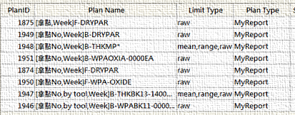
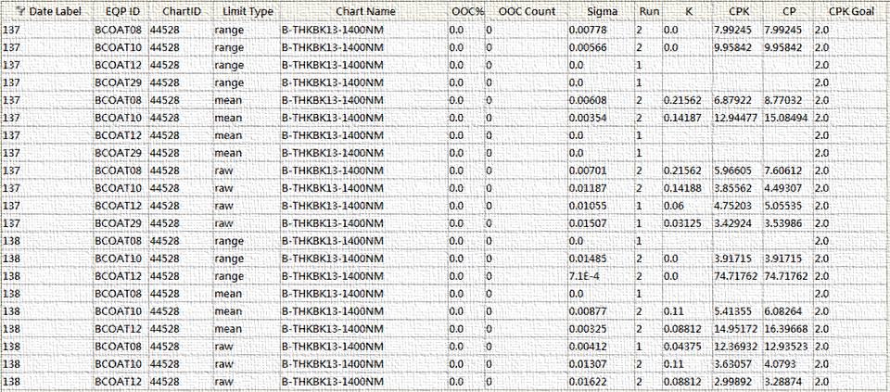
CFD Weekly Report
CFD key project - SPC Review Result
Strengthen SPC management
Add daily review
Check all chart (Cpk/Cp/k/OCAP ratio), and highlight abnormal chart
Create SPC function “My report”
To catch “abnormal point”
How to judge it’s “abnormal”
No. | Item | Highlight
1 | OOC | >10%
2 | K | > 0.1
3 | ∆K | >10%
4 | Cp | < Goal
5 | Cpk | < Goal
1
2
4
5
OOC%
K
Cpk
Cp
3
∆K

Slide 5
CFD Weekly Report
CFD key project - SPC Review Result
Strengthen SPC management
PE3 SPC management SOP
Annual health check/ New chart
Quarter health check
Healthy check
Create
Trace
Optimal
Review
Healthy check
-By tool check
Create new chart
-2 week check window
-SPEC: 4.5σ,Control:3.5σ
Trace new chart
-One month tracing
-check Sigma/OCAP…
Review chart
-Daily/ Weekly/ Monthly
If need optimal
Trace chart
-One month tracing
-check Sigma/OCAP…
Optimal SPEC
-according 1 month data
Healthy check
-Control limit~ 3.5σ
Optimal limit
-Past 3 months data
Review chart
-Daily/ Weekly/ Monthly

Slide 6
CFD Weekly Report
CFD key project - SPC Review Result
SPC Review Result
Create new chart SOP flow
New chart status tracing
Create
Trace
Optimal
Review
1
2
3
4
Create new chart
-2 week check window
-SPEC: 4.5σ,Control:3.5σ
Trace new chart
-One month tracing
-check Sigma/OCAP…
Review chart
-Daily/ Weekly/ Monthly
If need optimal
Trace chart
-One month tracing
-check Sigma/OCAP…
Optimal SPEC
-according 1 month data
No. |  | Chart ID |  | Chart Name |  | Status |  | Remark
1 |  | 72647 |  | B-ANG-SAD-2P |  | 2. Trace |  | AD4 contact angle (進點數未滿30個)
2 |  | 72396 |  | B-EBRMPB-2500UM |  | 2. Trace |  | CF8 MP EBR (BCOAT29) (進點數未滿30個)
3 |  | 72754 |  | F-ETROXA-ESC-0620A |  | 2. Trace |  | Vigus O2 ETCH (進點數未滿30個)
4 |  | 59322 |  | F-THKMPEW9-23um |  | 2. Trace |  | SMP008 THK (進點數未滿30個)
5 |  | 59321 |  | F-THKOXIA-1610A |  | 2. Trace |  | CVD THK 1.61K (進點數未滿30個)
6 |  | 59323 |  | F-RIOXIA-1.46 |  | 2. Trace |  | CVD RI 1.61K (進點數未滿30個)
7 |  | 21242 |  | F-ADHOXIA-0000ea |  | 2. Trace |  | 百格刀測試

Slide 7
CFD Weekly Report
CFD key project - SPC Review Result
SPC Review Result
PE3 chart summary
Off-target chart
No. | Type | Off-target (偏邊) |  | New chart
 |  | PASS | NG
1 | ADH | 5 |  | 1
2 | DPA | 27
3 | EBR | 4 |  | 1
4 | ETH | 2
5 | ETR | 16 | 3 | 1
6 | LEAK | 4
7 | RI | 3 |  | 1
8 | THK | 13 |  | 2
9 | WPA | 3
10 | ANG |  |  | 1
TTL |  | 76 | 3 | 7
No. |  | Chart ID |  | Chart Name |  | Action
1 |  | 39052 |  | F-ETRRWK-ULVAC |  | Low side tracing
2 |  | 23628 |  | F-ETROXA-ESC-0620A |  | Setting shift control limit (3.5 sigma)
3 |  | 70516 |  | F-ETROXA-ESC-0620A |  | Setting shift control limit (3.5 sigma)

Slide 8
CFD Weekly Report
CFD key project - SPC Review Result
SPC Review Result
W208 chart review

Slide 9
CFD Weekly Report
CFD key project - SPC Review Result
MP OCAP ratio
MP OCAP ratio investigation
Tighten MP THK monthly OCAP count ≤ 5 ea.
MP THK | Review | Index | During | SPEC
As is | Each chart | Ratio | Monthly | ≤ 10%
To be | Sum | Count | Monthly | ≤ 5 ea.
Chart name | OOC count |  |  |  | Root cause
 | 2021 |  |  | 2022
 | 10 | 11 | 12 | 01
F-THKMPDW3-79000A | 0 | 8 | 2 | 1 | FCOAT08 Low side
F-THKMPDW5-79000A | 0 | 2 | 1 | 1 | No abnormal
F-THKMPDW7-79000A | 8 | 2 | 0 | 2 | No abnormal
F-THKMPDWB-79000A | 2 | 5 | 5 | 3 | FCOAT09 U4
TTL | 10 | 17 | 8 | 7
TTL (-abnormal point) | 2 | 4 | 1 | 3

Slide 10
PE3 MOC case status

Slide 11
CFD Weekly Report
CFD key project - PE3 MOC case status
Description
MOC SOP flow
預計工程變更
MOC申請
MOC
ECCP/FCCB
放線
-確認
工程變更內容
-申請
請於放線前申請
-Pre MOC
Case呈報
-ECCP/FCCB
Case呈報
-結案
Status轉為Close
不須走MOC流程
-Internal MOC確認FCCB/ENG
Status轉為Open
-Post MOC
確認Enhance
確認Check list
No. | Item | Limit
1 | 調轉速 | RMS設定上下限內
2 | 曝光能量 | 原能量 ± 5%
3 | 正常泡復管 | 已經放線管路
4 | NTO/RTO | -
MOC
-結案

Slide 12
CFD Weekly Report
CFD key project - PE3 MOC case status
Status update
W208 have 1 MOC case closure
One new cases expected next week (W209)
PE3 Status | 2022 MOC record |  |  |  |  |  |  |  |  |  |  |  |  |  |  | MOC Close count
 | Jan. |  |  | W206 |  |  | W207 |  |  | W208 (Now) |  |  | W209
ENG | Pre | Post | Close | Pre | Post | Close | Pre | Post | Close | Pre | Post | Close | Pre | Post | Close
彭松崑
許綱謚 |  |  | 2 |  |  |  |  |  |  |  |  |  |  |  |  | 2
陳保龍
陳建宇 |  |  |  |  |  |  |  |  |  |  |  |  | 1
莊凱晴
侯坤劭 |  |  | 2 |  |  |  |  |  |  |  |  |  |  |  |  | 2
莊延年
池韋鋌
蔡詠翔
楊翔斌 |  | 1 [3/4] | 1 |  | 1 [3/4] |  |  | 1 [3/4] |  |  | 1 [3/4] |  |  |  |  | 1
曾國豪
張肯睿 |  |  |  |  |  |  |  |  | 1 |  |  |  |  |  |  | 1
林培舜 |  | 1 [2/8] |  |  | 1 [2/8] |  |  |  | 1 |  |  |  |  |  |  | 1
曾明良
林毓婷 |  |  | 1 |  |  |  |  |  |  |  |  |  |  |  |  | 1
林瑋屏 |  |  |  |  |  |  |  | 1 [2/11] |  |  |  | 1 |  |  |  | 1

Slide 13
CFD Weekly Report
CFD key project - PE3 MOC case status
Status update
W208 MOC case item
Change Date | FCCB / MOC No. | Dept | Tool | Change 詳述 | Change scope | EE | PE | PIE | Pre-meeting |  |  |  | Post-meeting |  |  | status
 |  |  |  |  |  |  |  |  | FCCB | RLS criteria | ENG | Date | Enhance results | Checking list | Date
2022/1/19 | PE_MOC_20220119_01 | PE3 | BEXPA14 | Release LS layer at BEXPA14 for back up tool | OV10635/OV10640/OV10642 | - | 楊翔斌 | - | Y | Inline | ADI KLA | 1/25 | ADI KLA | Y | 3/4 | Open
2022/2/7 | PE_MOC_20220207_01 | PE3 | FOVEF05 | Release FOVEF05 MP oven | ALL device MP layer | - | 林瑋屏 | - | Y | Inline | DRY PA PL test OM KLA | 2/8 | OM KLA | Y | 2/11 | Open

Slide 14
CFD Weekly Report
CFD major event - (MOC) Release FOVEF05 MP OVEN
Description :
Purpose : To increase producing capacity
Tool ID : FOVEF05
Recipe : 175℃ 兩小時 (04-O1752HR)
Action :
2/11 Release FOVEF05 MP OVEN
Data Collection :
Offline and Inline data is comparable with STD
Follow Up :
Burn in lot inline data is normal, suggest to fully release
Condition | Tool | Offline |  | Inline (Pirun/Burn in)
 |  | DryPA (ea.) | Peeling (ea.) | OM | KLA
STD | FOVEF04 | 2 | 0 | OK | OK
Spilt | FOVEF05 | 4 | 0 | OK | OK
Result |  | Data comparable |  | Data comparable

Slide 15
Mark8 Dynamic RMS For Recipe Space

Slide 16
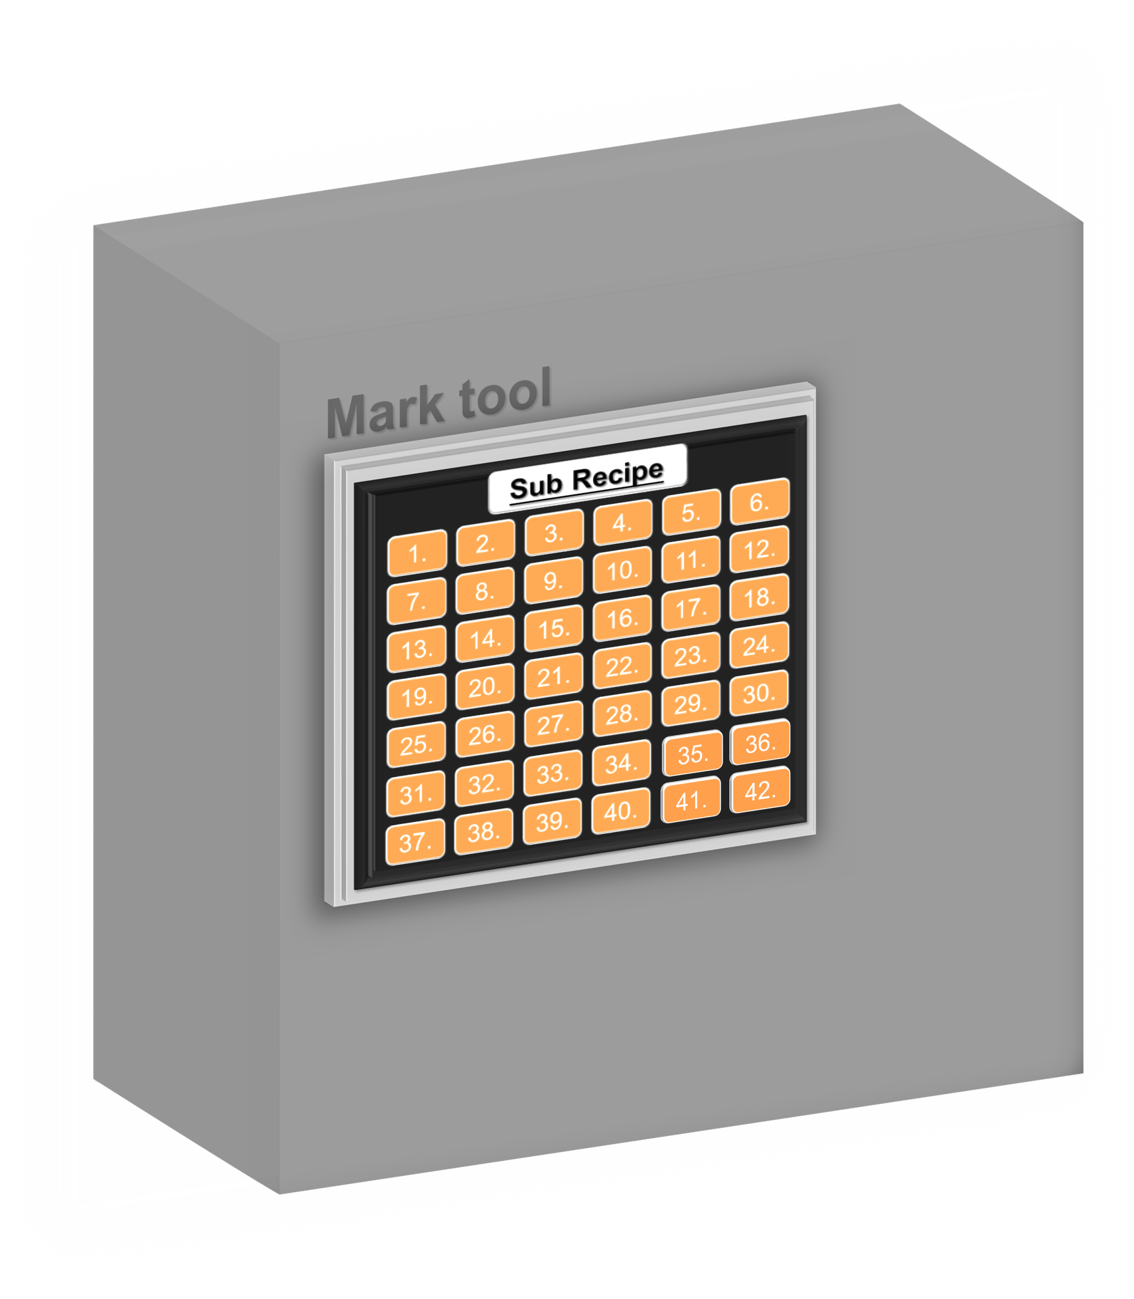

CFD Weekly Report
CFD key project - Mark8 Dynamic RMS For Recipe Space
格子數不足：
唉~怎麼格子又滿了?
又要先^{1.}刪掉現有的Recipe
然後^{2.}建立一個新的
讓貨先^{3.}開E-Runcard過貨
貨過完^{4.}又要把Recipe改回去
好容易MO唷!!

Slide 17











CFD Weekly Report
CFD key project - Mark8 Dynamic RMS For Recipe Space
What’s dynamic RMS :
A
A
4.
10.
B
B
16.
20.
C
C
彈性
空間
27.
31.
A
A
滿了!
36.
A
35.
拜~
更多的空間
A
43.
46.
機台上建立每個架構殼
41.
42.
RBG PR
and different recipe body
系統會抓取當下的主轉
雲端
43.

Slide 18


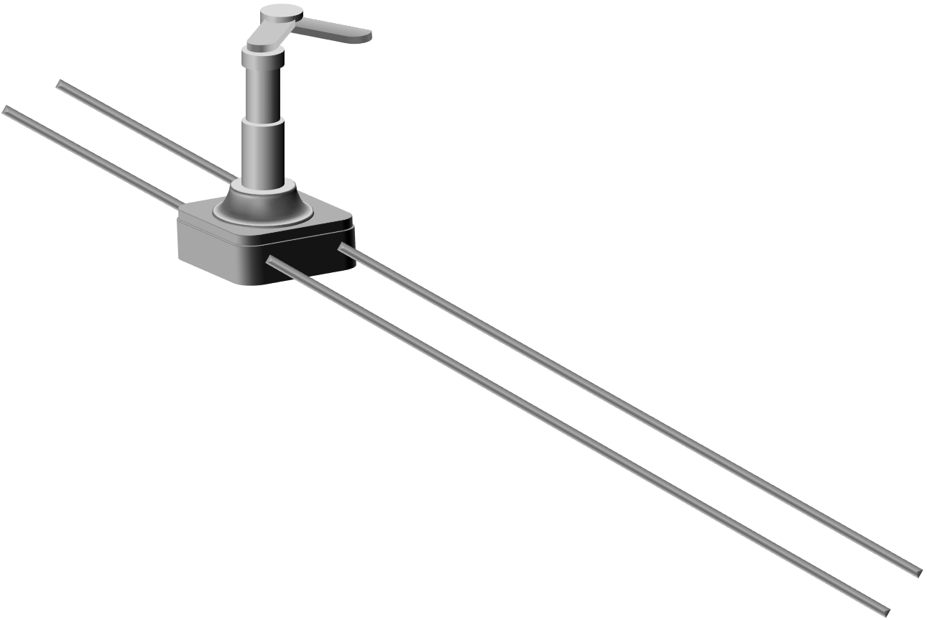
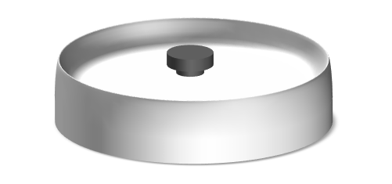







CFD Weekly Report
CFD key project - Mark8 Dynamic RMS For Recipe Space
Case1 : Track in while running (Update fail)
Condition
Track in @Unit with wafer
Different Rotational speed (Same recipe body)
Same PR
Same unit
Track in
Track in
2000
RPM
1800
RPM
Load port
1800
RPM
1800
RPM
1800 RPM
1800 RPM
Unit
Wrong rotational speed

Slide 19

CFD Weekly Report
CFD key project - Mark8 Dynamic RMS For Recipe Space
Case2 : Track in while non-running (Overwrite)
Condition
Track in @Unit without wafer
Different recipe (Different Rotational speed)
Same PR
Same unit
Track in
Track in
2200
RPM
Track in
2000
RPM
1800
RPM
2200
RPM
Load port
2200
RPM
2200
RPM
2000 RPM
2200 RPM
1800 RPM
Unit
Wrong rotational speed

Slide 20

CFD Weekly Report
CFD key project - Mark8 Dynamic RMS For Recipe Space
Solution : Constraint function
Add the function of CJ start/ CJ end
Track in @Unit with/without wafer
Different Rotational speed (Same recipe body)
Same PR
Same unit
Track in
Track in
2000
RPM
Wafer in
Wafer in
1800
RPM
Load port
1800
RPM
2000
RPM
1800 RPM
2000 RPM
Unit
Right rotational speed

Slide 21
CFD Weekly Report
CFD key project - Mark8 Dynamic RMS For Recipe Space
Conclusion
Summary | Recipe body
 | Same |  | Diff.
 | Rotational speed |  | Rotational speed
 | Same | Diff. | Same | Diff.
Same PR | Continuous | Continuous Non-Continuous | Continuous | Continuous
Diff. PR | Non-Continuous | Non-Continuous | Non-Continuous | Non-Continuous

